Slide 1

Project Methods and Professionalism
Project Management - Quality
Who should define quality?

Slide 2

Lecture objectives
What is quality?
Modern quality management and the “quality” movement
Quality management processes
ECU Copyright 2015 – CSG 2344 School of Computer and Security Science

Slide 3
What is quality?
degree of excellence…superiority (Oxford Dictionary)
conformance to requirements. (Crosby)
software quality assurance definition
But who defines quality? The client or the IT team? Requirements are not expectations.
ECU Copyright 2015 – CSG 2344 School of Computer and Security Science
Notes:
from SQA standpoint
Mercedes not nec better quality car
more prestigious, expensive, impressive…
but Lada may be higher quality in SQA sense if
built correctly to specifications
correctly following production standards ...

Slide 4
63,000 known bugs in Windows 2000?
In February 2000, a Microsoft Corp memo caused quite a stir when it was leaked to the public. An excerpt from that memo reads:
“Our customers do not want us to sell them products with over 63,000 potential defects. They want those defects corrected. How many of you would spend $500 on a piece of software with over 63,000 potential known defects?”
ECU Copyright 2015 – CSG 2344 School of Computer and Security Science

Slide 5
Many people make a joke about the poor quality of IT
Bill Gates: “If General Motors had kept up with technology like the computer industry has, we would all be driving twenty-five dollar cars that got 1000 miles to the gallon.“
GM response
For no reason whatsoever your car would crash twice a day.
Occasionally, executing a manoeuvre such as a left turn, would cause your car to shut down and refuse to restart, in which case you would have to reinstall the engine.
The airbag system would say "Are you sure?" before going off.
Occasionally for no reason whatsoever, your car would lock you out and refuse to let you in until you simultaneously lifted the door handle, turned the key, and grab hold of the radio antenna.
Every time GM introduced a new model car buyers would have to learn how to drive all over again because none of the controls would operate in the same manner as the old car.
You press the "start" button to shut off the engine.
ECU Copyright 2015 – CSG 2344 School of Computer and Security Science

Slide 6
Modern Quality Management
Modern quality management:
  Requires customer satisfaction.
  Prefers prevention to inspection.
  Recognizes management responsibility for quality.
Noteworthy quality experts include Deming, Juran, Crosby, Ishikawa, Taguchi, and Feigenbaum.
ECU Copyright 2015 – CSG 2344 School of Computer and Security Science

Slide 7
The Quality Movement
Early humankind
  Quality = Survival
Craftsmanship
  Guilds in the middle ages guilds regulated and controlled quality
The industrial revolution
  Mass production
  machines could build parts and men could learn to operate the machines
The question is whether software development is more like craftsmanship or mass production!
ECU Copyright 2015 – CSG 2344 School of Computer and Security Science

Slide 8
The Quality Movement
The Rise of Japan
  W. Edwards Deming (1900 – 1993)
    Worked Western Electric in Chicago in the 1920s
    Management treated the worker as a cog in the machinery
    Final inspection used to control quality
      Worker not directly responsible
    Invited to give series of lectures in Japan in the 1950s
    The rest is history…
ECU Copyright 2015 – CSG 2344 School of Computer and Security Science

Slide 9
Some of Deming’s 14 Points
Don’t depend on inspection at the end.
Keep improving constantly.
Institute training on the job.
Institute leadership
Drive out fear.
Break down barriers between departments.
Eliminate quotas
Take pride in your work.
Focus education and self-improvement.
It takes everyone to accomplish the transformation.
…These would apply to software development
ECU Copyright 2015 – CSG 2344 School of Computer and Security Science

Slide 10
The quality thrust
in the short term - quality costs
in the long term - lack of quality costs
    Deming
commitment to quality is a trait that is evident in successful companies
total quality management
  an all-pervading organisational approach to quality
ECU Copyright 2015 – CSG 2344 School of Computer and Security Science

Slide 11
Deming’s Philosophy
Quality = Result of Work efforts
Total Costs
The idea is that if you focus on work efforts, quality tends to increase and costs fall over time.
However – when people or organisations focus primarily on costs – then costs tend to rise and quality falls over time.
ECU Copyright 2015 – CSG 2344 School of Computer and Security Science

Slide 12
The Quality Movement
The Rise of Japan continued
  Kaoru Ishikawa (1915 - 1989)
    Studied under Deming
    Believes quality is a continuous process that relies on all levels of the organization
    Advocated the use of easy-to-use statistical tools
      Pareto Diagram
      Ishikawa, or Fishbone Diagram
      Flow Charts
ECU Copyright 2015 – CSG 2344 School of Computer and Security Science

Slide 13
Pareto Analysis
Pareto analysis involves identifying the vital few contributors that account for the most quality problems in a system.
Also called the 80-20 rule, meaning that 80 percent of problems are often due to 20 percent of the causes. So it helps to identify where improvements will have the biggest effect
Pareto diagrams are histograms, or column charts representing a frequency distribution, that help identify and prioritize problem areas.
ECU Copyright 2015 – CSG 2344 School of Computer and Security Science

Slide 14
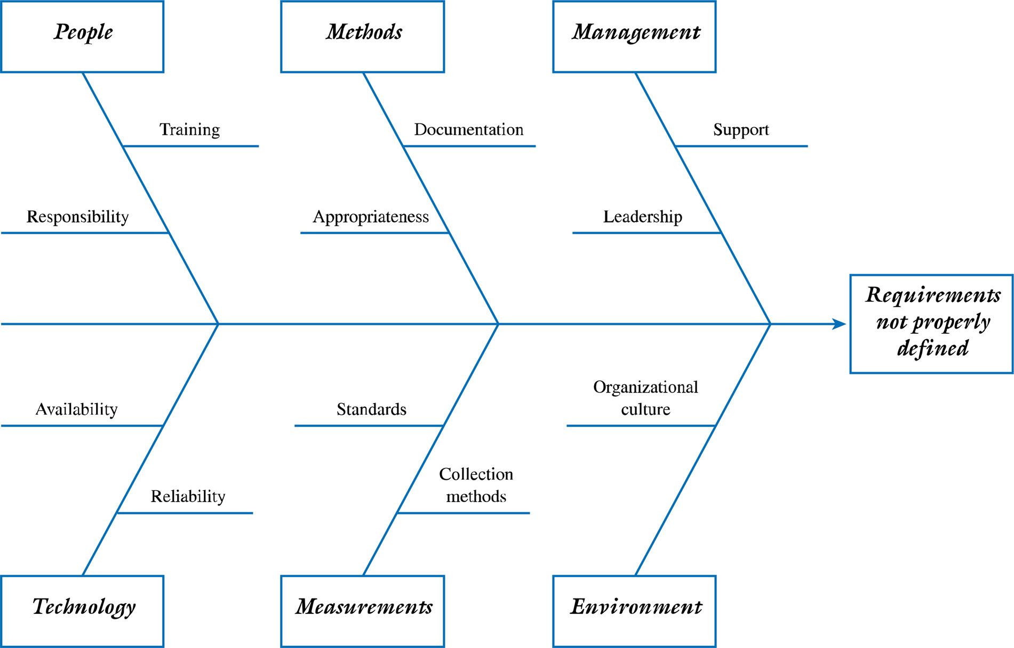
Ishikawa, or Fishbone Diagram
Good for showing
how factors
contribute to
problems

Slide 15
Quality Systems
International Organization for Standardization (ISO)
  facilitate the international coordination and unification of industrial standards.”
ISO 9000 is a quality system standard that:
  continuous cycle of planning, controlling, and documenting quality in an organization.
  Provides minimum requirements needed for an organization to meet its quality certification standards.
  Helps organizations around the world reduce costs and improve customer satisfaction.
ECU Copyright 2015 – CSG 2344 School of Computer and Security Science

Slide 16
Quality Management processes - PMBOK®
The processes required to ensure that the project will satisfy the needs for which it was undertaken.
It includes all activities of the overall management function that determine the quality policy, objectives, and responsibility and implements them by means of
quality planning,
quality assurance,
quality control, and
quality improvement
ECU Copyright 2015 – CSG 2344 School of Computer and Security Science

Slide 17
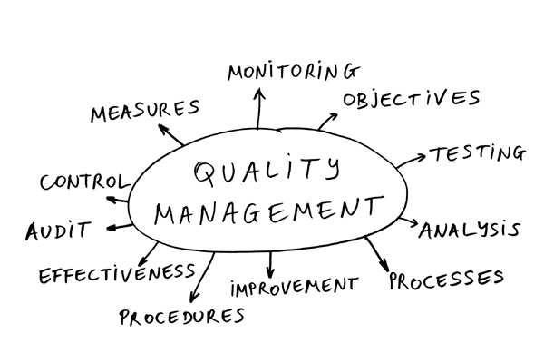
The IT Project Quality Plan - Quality Plan - Purpose and Policy
Focus on customer satisfaction
Prevention not inspection
Improve the process to improve the product
Quality is everyone’s responsibility
Fact-based management
ECU Copyright 2015 – CSG 2344 School of Computer and Security Science

Slide 18

Quality assurance procedures
A broad term which includes
management reviews
peer reviews
  Walk-throughs
  inspections
Work outputs are evaluated by others to:
  measure progress
  identify and expose errors
  impose standards
ECU Copyright 2015 – CSG 2344 School of Computer and Security Science

Slide 19
Management reviews
A presentation to management/client usually coinciding with a project milestone
  Are designed to ensure that the IT solution provides the required functionality defined in the project scope and detailed requirements definition to ensure that a particular project deliverable
    Is complete
    Provides information necessary for the next phase or process
    Meets predefined standards
    Conforms to the project (and software development) methodology
Reviewers need knowledge, experience to assess and be empowered to approve ...
ECU Copyright 2015 – CSG 2344 School of Computer and Security Science

Slide 20

Peer reviews
Walkthrough
peer group reviews of all items associated with a software product eg
  prototype
  data flow diagram
  requirements specification
  pseudocode
  code
  presentations ...
ECU Copyright 2015 – CSG 2344 School of Computer and Security Science

Slide 21
Walkthroughs
need to be conducted formally
attendees selected for ability to contribute
material distributed prior to event
presenter leads the group through the item with reference to task description, standards ...
walkthrough record produced
  attendees
  problem areas recorded
ECU Copyright 2015 – CSG 2344 School of Computer and Security Science

Slide 22
Walkthrough rules
require moderator, presenter, recorder, attendees.
not designed to evaluate presenter
presenter responsible for distribution of materials in time for adequate reviewing
action items carefully documented
outcomes
  if minor problems: later confirmation by moderator that problems addressed
  if serious problems identified: further walkthrough
ECU Copyright 2015 – CSG 2344 School of Computer and Security Science
Notes:
evaluate the quality of the walkthrough itself

Slide 23
Value of peer reviews
strict discipline
  substantial increase in quality
educational
  new team members are more easily able to conform to standards - peer work is visible
everyone in team responsible for quality
other reviewing techniques
  self reviews ie desk checking
  inspections: work reviewed by peer(s) individually
ECU Copyright 2015 – CSG 2344 School of Computer and Security Science

Slide 24
Testing procedures
Verification – Reviewing the Process
  Focuses on process-related activities to ensure that the products & deliverables meet specified requirements before final testing
  Are we building the product in the right way?
Validation – Reviewing the Product
    Does the system function as intended and have all the capabilities & features defined in the project’s scope and requirements definition?
    Are we building the right product?
ECU Copyright 2015 – CSG 2344 School of Computer and Security Science

Slide 25
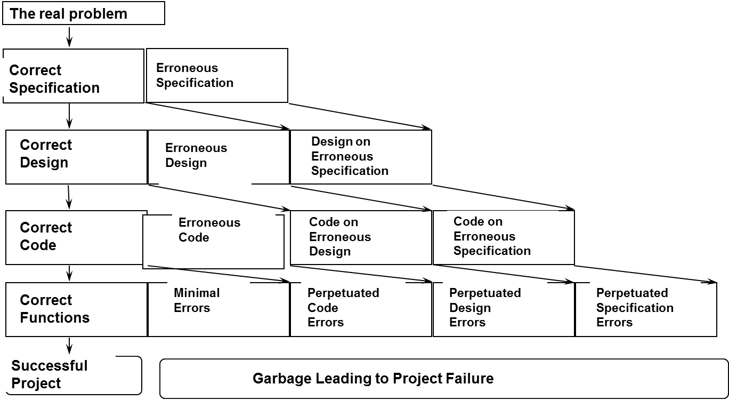
Accumulative Effects of Error

Slide 26
Software Testing Approaches
Unit Testing
Focuses on the module, program, or object level to determine whether specific functions work properly.
Black Box Testing – Tests the program against specified requirements or functionality.
White Box Testing – Examines paths of logic or the structure inside a program.
Gray Box Testing – Focuses on the internal structure of the program.
Integration Testing
Tests whether a set of logically related units (e.g., functions, modules, programs, etc.) work together properly after unit testing is complete.
Systems Testing
Tests the system as a whole in an operating environment to verify functionality and fitness for use. May include tests to verify usability, performance, stress, compatibility, and documentation.
Acceptance Testing
Certifies that the system satisfies the end user or customer’s scope and detailed requirements after systems testing is complete. It is the user’s or client’s responsibility to assure that all features and functionality are included
ECU Copyright 2015 – CSG 2344 School of Computer and Security Science

Slide 27

Change Control and Configuration Management
Component Identification
  Naming conventions
Version Control
  Evolutionary changes
Change Control
  Proposed changes are evaluated, approved or rejected, scheduled, and tracked
  Reporting & auditing
ECU Copyright 2015 – CSG 2344 School of Computer and Security Science

Slide 28
Process improvement
Lessons learned
  Provide the basis for continual improvement
  Can be the basis for identifying and implementing best practices
A quality plan should do more that attempt to build a better IT solution,
it should also support the organization in searching for ways to manage
projects better.
ECU Copyright 2015 – CSG 2344 School of Computer and Security Science

Slide 29

Maturity Models
Maturity models are frameworks for helping organizations improve their processes and systems.
The Software Engineering Institute’s Capability Maturity Model (CMM) is a five-level model laying out a generic path to process improvement for software development in organizations.
Can measure the maturity of an organization’s software process
Can evaluate its software process capability
Help prioritize improvement efforts
CMM levels, from lowest to highest, are:
  Initial
  Repeatable
  Defined
  Managed
  Optimizing
ECU Copyright 2015 – CSG 2344 School of Computer and Security Science

Slide 30
Process improvement - CMM
Immature Software Organization
  Reactive in nature - Managers continually “fight fires”
  Schedules & budgets are usually exceeded
  Functionality & quality often compromised to meet schedules
  Project success determined by who is or is not part of the project team
  No basis for judging quality
  Never seems to be enough time to address problem issues or improve the current processes

Slide 31
Process improvement - CMM
Mature Software Organization
  Proactive and able to follow a set of disciplined processes throughout the software project.
  Software processes and the roles of individuals are defined explicitly and communicated throughout the organization.
  Software processes are monitored and continually improved based on experimentation or experiences.
  Budgets and schedules are based on past projects so they are more realistic and the project goals and objectives are more likely to be achieved.

Slide 32
Summary
What is quality?
Modern quality management and the “quality” movement
Quality management processes
  Remember … most QM is about trying to guarantee the quality of the process rather than trying to guarantee the quality of the end product.
  Is this satisfactory?
ECU Copyright 2015 – CSG 2344 School of Computer and Security Science

